Slide 2
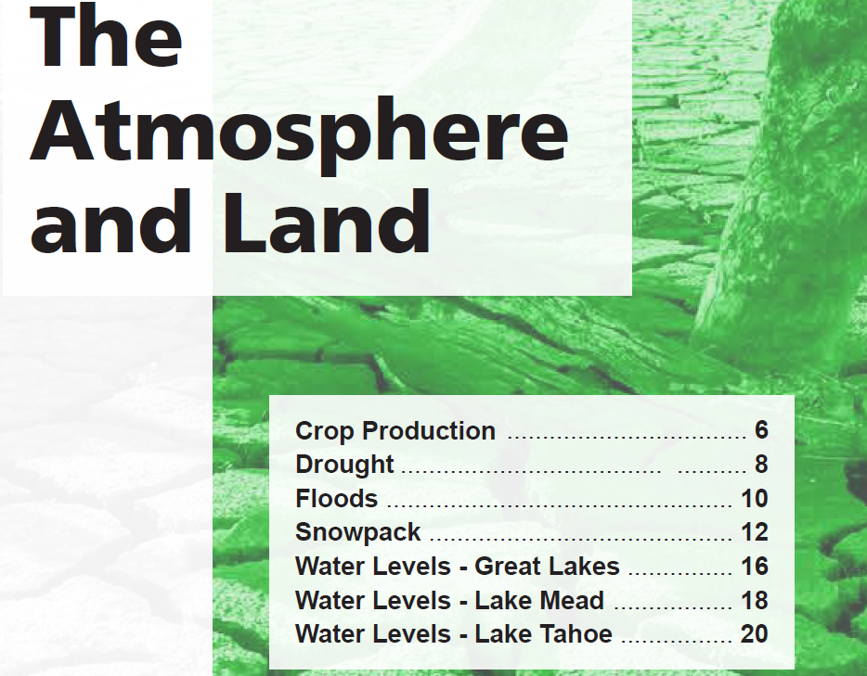
Section 1

Slide 3
Global crop yields have set new records almost every year as our planet has modestly warmed.
U.S. crop yields have continued to grow, setting new records nearly every year.
Longer growing seasons, higher temperatures, and greater concentrations of atmospheric carbon dioxide are creating ideal crop conditions.

Slide 4
The U.N. Food and Agriculture Organization reported in December 2020 that annual global cereal production increased by 1.3 percent compared to 2019, despite production constraints caused by the COVID-19 pandemic.
Global warming lengthens growing seasons, reduces frost events, and makes more land conducive for crop production.
Moreover, carbon dioxide greatly benefits crop production, as atmospheric carbon dioxide works as an aerial fertilizer. Higher atmospheric carbon dioxide levels assist photosynthesis for plant growth and resistance to drought.
Cereal production, utilization, and stocks. Source: U.N. Food and Agriculture Organization, “World Food Situation,” fao. org, July 8, 2021, accessed July 25, 2021, http://www.fao.org/worldfoodsituation/csdb/en

Slide 5
The United States has benefited from additional precipitation and a reduction in drought conditions as the climate has modestly warmed.
The United States set records in 2017 and 2019 for having its smallest percentage of land area experiencing drought conditions.
The U.N. Intergovernmental Panel on Climate Change (IPCC) reports with “high confidence” that precipitation has increased over mid-latitude land areas of the Northern Hemisphere (including the United States) during the past 70 years, while IPCC has “low confidence” about any negative trends globally.
Droughts have always occurred, and always will. Available evidence shows the droughts that have occurred in recent years were not caused or worsened by global warming. Instead, global and U.S. drought data show recent droughts were less frequent and severe than the droughts of the early and mid twentieth century.

Slide 6
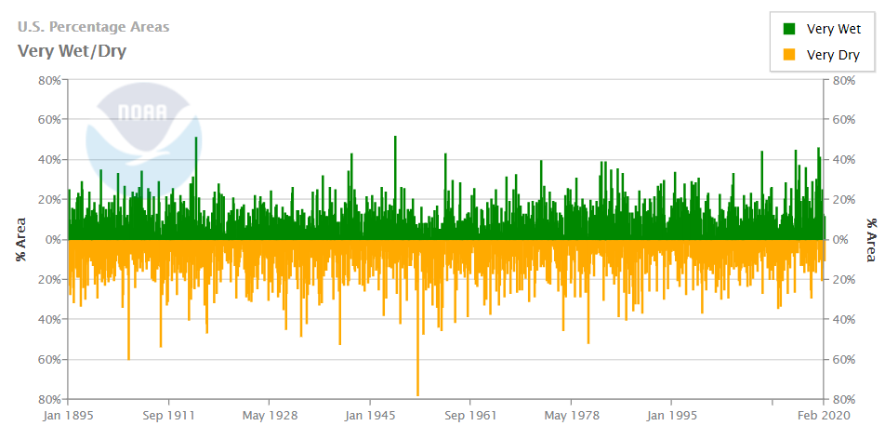
This chart shows that the United States is undergoing its longest period in recorded history without at least 40 percent of the country experiencing “very dry” conditions. Note also the peaks in drought around 1978, 1954, 1930, and 1900 are much larger than what the U.S. experienced in the 21st century and the late 20th century.
Percentage of United States experiencing “very wet” (in green) and “very dry” (in yellow) conditions. Source: National Oceanic and Atmospheric Administration: https://www.ncdc.noaa.gov/temp-and-precip/uspa/wet-dry/0

Slide 7
The U.N. Intergovernmental Panel on Climate Change (IPCC) reports it has “low confidence” climate change is impacting flooding.
The IPCC admits having “low confidence” in even the “sign” of any changes. In other words, it is just as likely that climate change is making floods less frequent and less severe as it is more frequent and more severe.
Studies of rivers and streams that have not been altered by human development show no or very little increase in flooding events.
Floods always have and always will occur. With no increase in overall flooding activity, there is no justifiable reason to blame any recent, current, or near-future flooding events on climate change.

Slide 8
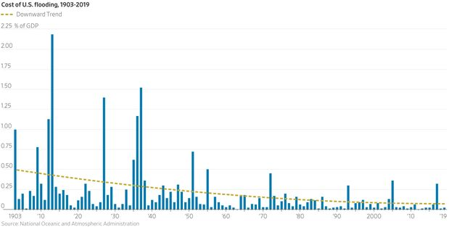
NOAA has documented a significant reduction in the costs associated with flooding in the United States over the past century.
In the 2018 National Climate Assessment published by NOAA, it is stated on page 99,
“Human-induced warming has not been formally identified as a factor in increased riverine flooding and the timing of any emergence of a future detectable human caused change is unclear.”
U.S. flood damage as a proportion of U.S. gross domestic product. Data plotted by Dr. Bjorn Lomborg. Data Source: National Oceanic and Atmospheric Administration.

Slide 9
Average North American snowpack extent is virtually the same as it was in the late 1960s, when U.S. satellite measurements began.
Following a short-term decline in snowpack in the mid-1980s, average North American snowpack has increased.
There has been only a modest decline in Eurasian snowpack in recent years.

Slide 10
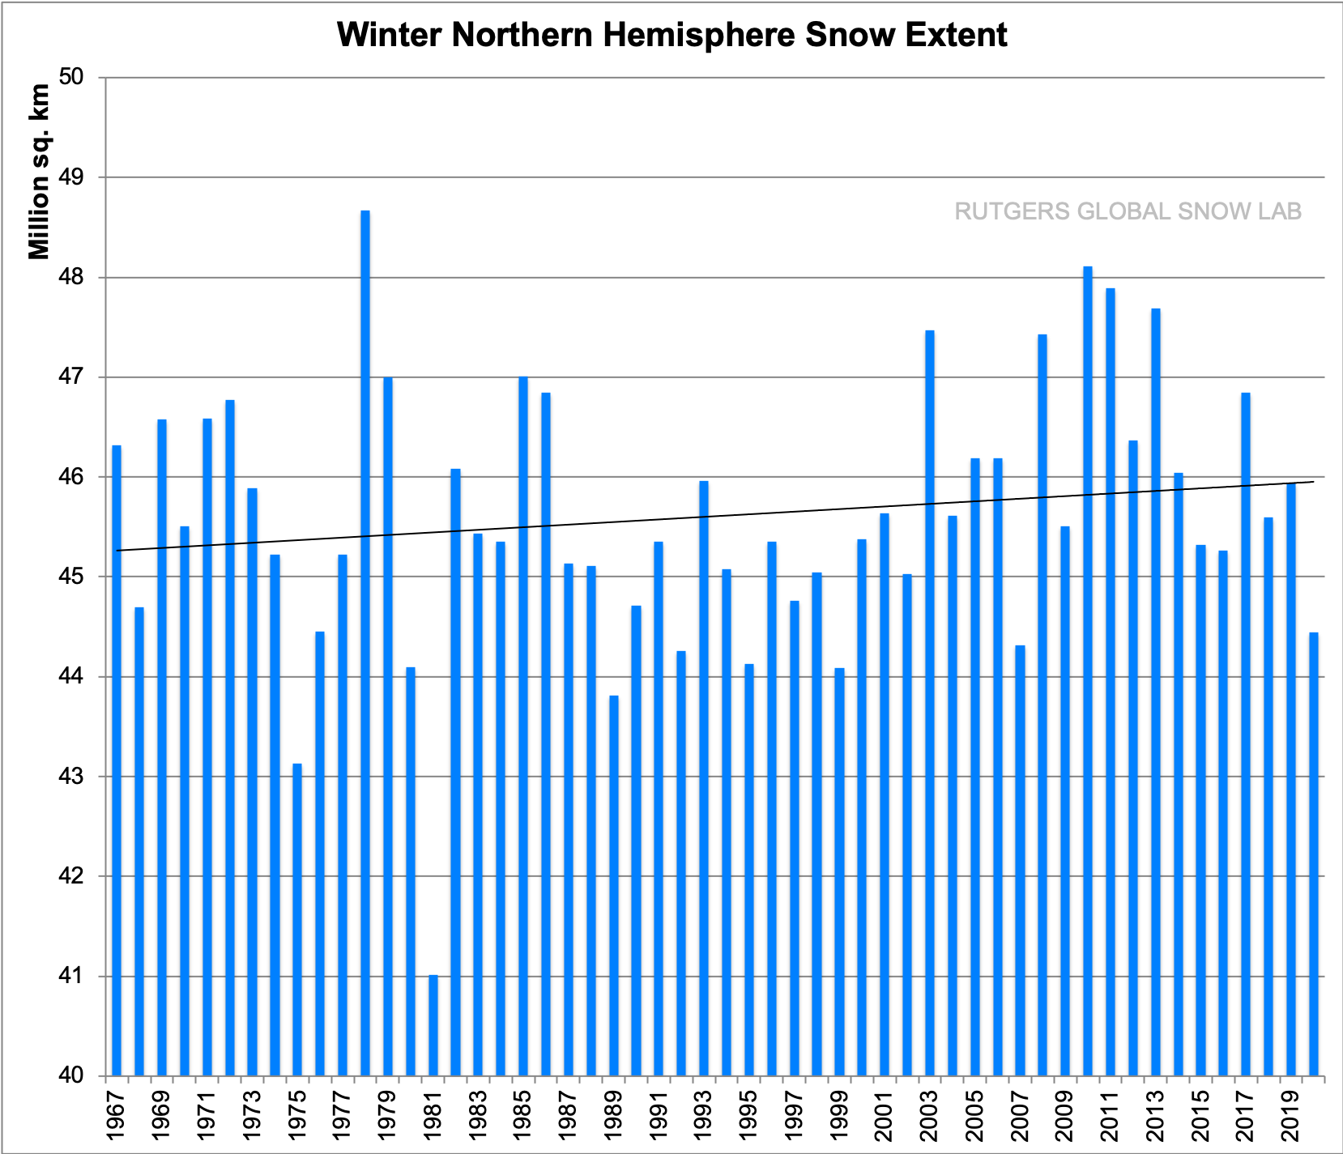
This chart shows winter Northern Hemisphere snow extent.
Note that global snow cover throughout the Northern Hemisphere has increased during the winter months since the 1960s.
Source: Global Snow Lab, “Winter Northern Hemisphere Snow Extent,” Rutgers University Climate Lab, accessed December 2020,
https://climate.rutgers.edu/snowcover/chart_seasonal.php?ui_set=nhland&ui_season=1

Slide 11
The Great Lakes are benefiting from record high water levels, just a few years after climate activists claimed global warming would cause water levels to drop.
Water levels have been above average since 2014.
Many activists now claim global warming causes high water levels, but they have already claimed global warming causes low water levels, calling into question activists’ assertion that the science is “settled” on climate change and its consequences.
Any attempts to claim global warming causes water-level volatility are also contradicted by scientific evidence and the historical record. For example, water levels were more volatile in the late 1920s and the 1960s than they are today.

Slide 12
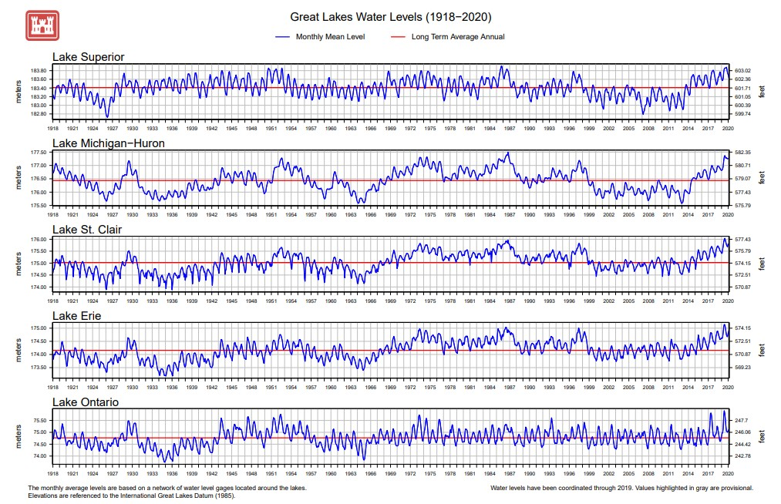
In recent years, Great Lakes water levels have experienced record-high marks, and they have been higher than average since 2014.
In a complete reversal of their previous predictions and warnings, climate activists now claim the high water levels of the Great Lakes are creating a new crisis and that climate change is the cause.
High, low, and variable water levels are a longstanding component of the history of the Great Lakes, and as shown at left, water levels were more volatile in the late 1920s and 1960s than they are today.
Source: U.S. Army Corps of Engineers, “Great Lakes Water Level Data,” accessed July 24, 2021, https://www.lre.usace.army.mil/Missions/Great-Lakes-Information/Great-Lakes-Information-2/Water-Level-Data

Slide 13
Lake Mead water levels rose steadily from 1965 to 1983, setting record-high levels in 1983.
For all but two years of the three decades running from 1973 to 2002, water levels remained above average, the longest such period on record.
After nearly 30 years of abundance, a decline was bound to eventually occur.
Rainfall has been below average in recent years in the Colorado River Basin, but above average nationally.
Some regions of the world are always going to be drier than others, with or without global warming.

Slide 14
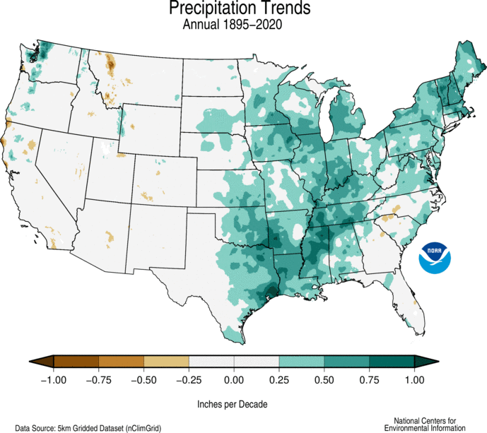
This figure shows U.S. precipitation trends during the 1895–2020 period.
Note that precipitation has increased throughout much of the United States during the past century as the planet has warmed, contradicting claims made by many climate activists insisting that global warming is causing droughts and severe drops in water levels.
Also note that the Western United States, shown in grey in the figure, has not experienced a strong trend during the studied period.
Source: National Centers for Environmental Information, “United States Precipitation Trends 1895–2020,”
National Oceanic and Atmospheric Administration, accessed July 12, 2021, https://www.ncdc.noaa.gov/monitoring-content/ temp-and-precip/us-trends/prcp/trends-prcp-ann-por-full.gif

Slide 15
Lake Tahoe reached its maximum allowable water level in 2017–19, requiring special water releases into the Truckee River.
The 2015–16 Northern California drought was very brief and followed by three consecutive years of abundant precipitation. During that period, Lake Tahoe reached its maximum allowable water level.
Climate activists claiming the 2015–16 drought signaled a “new normal” of drought and low water levels caused by climate change have been proven wrong.

Slide 16
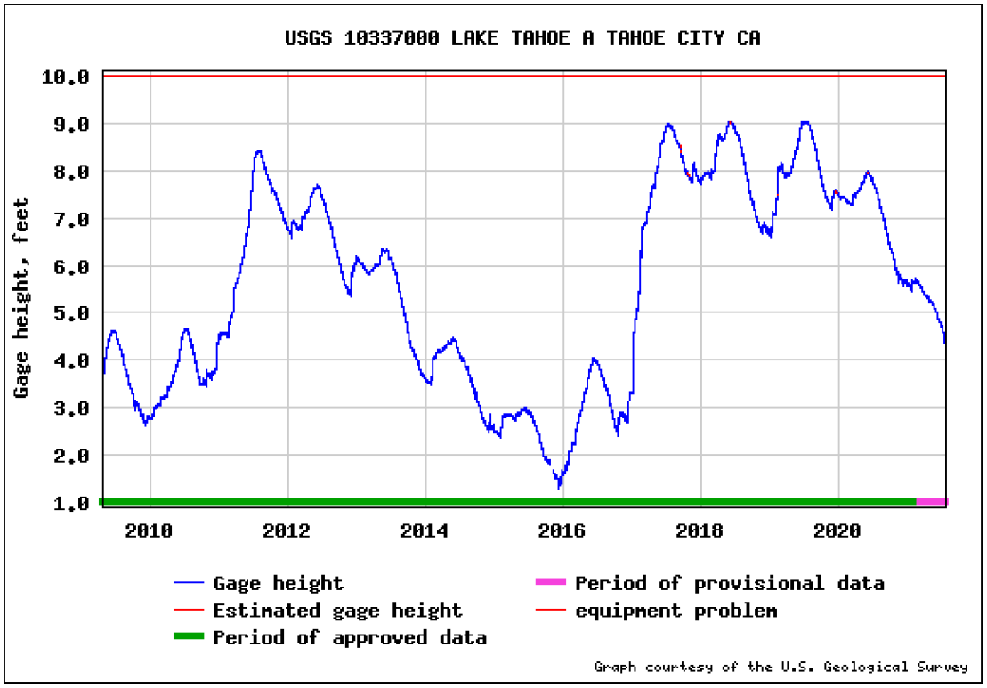
Note that Lake Tahoe reached its maximum allowable water limit in 2017, 2018, and 2019.
The failed predictions about Lake
Tahoe’s water levels provides an
excellent illustration of how climate
alarmists use singular events to
erroneously make arguments about
the dangers of climate change.
In the case of the 2015–16 drought affecting
Lake Tahoe, climate alarmists claimed
a normal, variable event like a brief
drought offered proof of a permanent
“climate emergency”.
Source: U.S. Geological Survey, “USGS 10337000 Lake Tahoe A Tahoe City CA,” U.S. Geological
Survey, National Water Information System, Accessed July 24, 2021,
https://nwis.waterdata.usgs.gov/nwisweb/graph?agency_cd=USGS&site_no=10337000&parm_cd=00065&period=4478

Slide 17
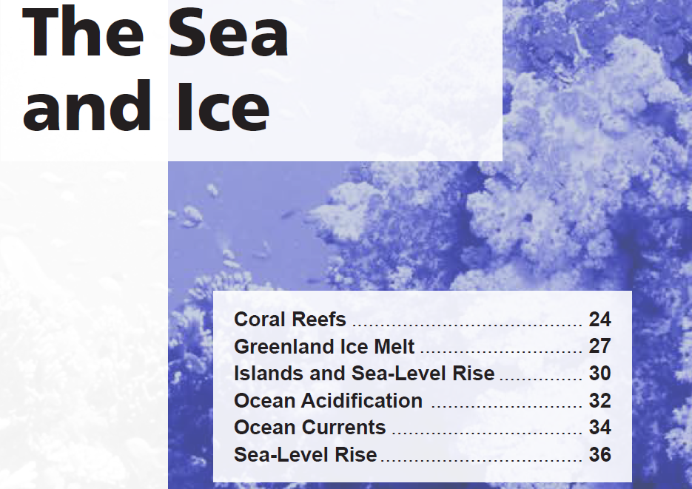
Section 2

Slide 18
Corals thrive in warm water, not cold water.
Recent warming has allowed corals to expand their range poleward while still thriving near the equator.
Corals have existed continuously for the past 40 million years, surviving temperatures and carbon dioxide levels significantly higher than what is occurring today.
The primary causes of coral bleaching, which vary based on the time and location, include oxybenzone (a chemical found in sunscreen), sediment runoff from nearby coastal lands, fertilizer and nitrogen loading from agriculture, and lower temperatures like those recorded in 2010 off the Florida coast.

Slide 19
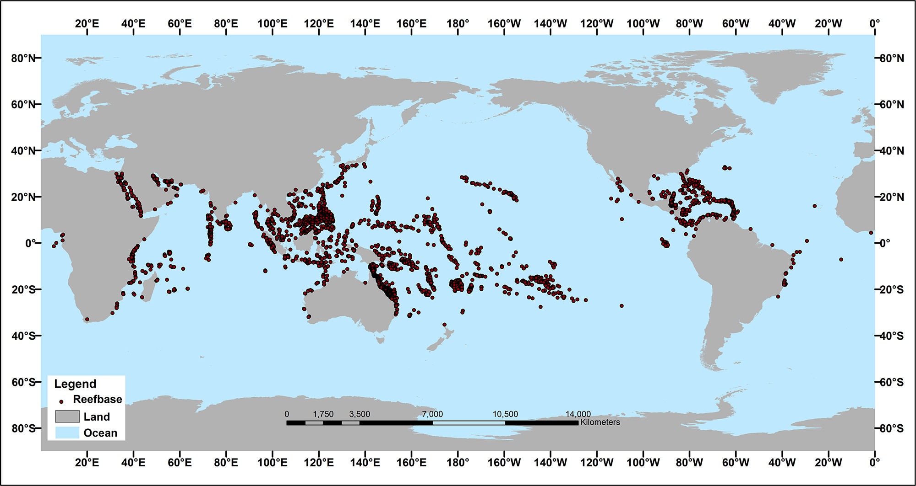
Corals thrive in the warmest of Earth’s waters.
The poster child for coral alarmism is the Great Barrier Reef in Australia. The Australian Institute of Marine Science documented that approximately 22 percent of the Great Barrier Reef experienced bleaching recently, not 93 percent, as reported in some erroneous media stories. Perhaps most importantly, recent evidence shows much of the bleached corals in the Great Barrier Reef are fully recovering.
Source: National Ocean Service, “Where Reef Building Corals Found,” National Oceanic and Atmospheric Administration, accessed July 26, 2021, https://oceanservice.noaa.gov/education/tutorial_corals/media/supp_coral05a.html

Slide 20
Climate activists, including government bureaucrats, claim the Greenland ice sheet is melting six times faster than it was 30 years ago, but 30 years ago, the Greenland ice sheet was barely melting at all.
Six times almost no ice loss is hardly an example of a climate change crisis.
When recent ice loss is compared to the full Greenland ice sheet, the loss is so miniscule that it is practically undetectable.

Slide 21
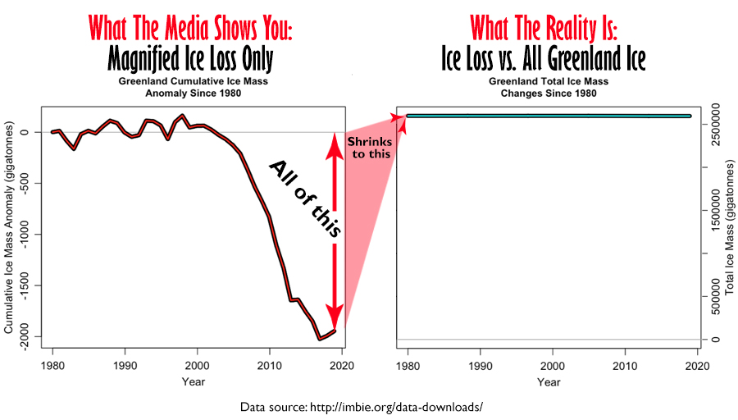
A comparison of presentations of satellite data capturing Greenland’s ice mass loss.
The image on the right shows changes in Greenland’s ice mass relative to Greenland’s total ice mass.
The data plotted in these graphs are from the Ice Sheet Mass Balance Inter-Comparison Exercise, a joint exercise by NASA and the European Space Agency

Slide 22
Most islands and atolls in the Pacific Ocean, including Tuvalu, are increasing in size, not shrinking.
As the sea gradually rises, it brings sand and sediment along with it, building up island shorelines at a rate that offsets modest sea-level rise.
Despite many predictions that island nations in the Pacific would spawn waves of climate refugees, the population of Tuvalu and other islands have steadily grown, not decreased.

Slide 23
Climate activists often claim the island nation of Tuvalu is sinking under rising seas and spawning climate refugees. However, a recent peer-reviewed study found 8 out of Tuvalu’s 9 coral atolls have grown in size during recent decades, and 3/4ths of Tuvalu’s 101 reef islands have similarly grown in size.
Additional peer-reviewed studies confirm the same processes are allowing – and will continue to allow – other Pacific islands to keep up with rising seas.
30 years ago, the Canberra Times claimed all 1196 islands that comprise the Maldives could be completely underwater by now. They aren’t.
Coral atolls, Maldives. Note that the coral rings “float” with the sea level, and because they are living things, they rise with the sea level as new coral grows. Source: Pinterest

Slide 24
Ocean water is not overly acidic. It is not even close to being acidic.
A pH of 7 is considered neutral. A pH below 7 is acidic. A pH above 7 is alkaline.
The pH of the oceans averages 8.1, and it ranges from 7.8 to 8.5. By comparison, rainwater is “acidic,” averaging 5.6.
Since 1850, the pH of surface ocean waters has fallen by merely 0.1 pH units, but that is an estimate, not a measurement.
The health of ocean life is improved, not harmed, by more carbon dioxide (CO2). CO2 is food for phytoplankton that form the foundation of the marine food chain. Marine life thrives and improves growth rates in elevated CO2 conditions.

Slide 25
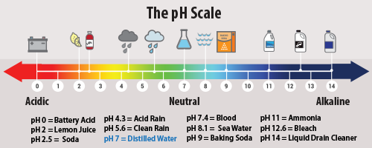
As the figure shows, “sea water” has an average pH of 8.1, the oceans are a long way from turning acidic which would be a pH below 7.0.
Climate models suggest the ocean’s surface pH may have dropped from pH of 8.2 to 8.1 since 1750, though that change was never actually measured.
It is likely that media reports often use the word “acidic” because it sounds scarier than a more accurate description, such as “a modeled, modest decline in alkalinity.”
Comparison of the pH of common substances.
Source: U.S. Environmental Protection Agency, “Measuring Acid Rain,” epa.gov, last accessed August 12, 2021,
https://www.epa.gov/acidrain/what-acid-rain

Slide 26
For many years, global warming activists claimed global warming would soon cause ocean currents to slow to a pace that has not been experienced in more than 1,000 years.
Climate activists claimed computer models predicted the slowdown and that a slowdown would cause disastrous consequences on marine life.
They also suggested it could cause a new “mini” ice age.
However, recent peer-reviewed research has falsified these claims. The best-available science shows ocean currents have sped up over the past 20 years, not slowed down.

Slide 27
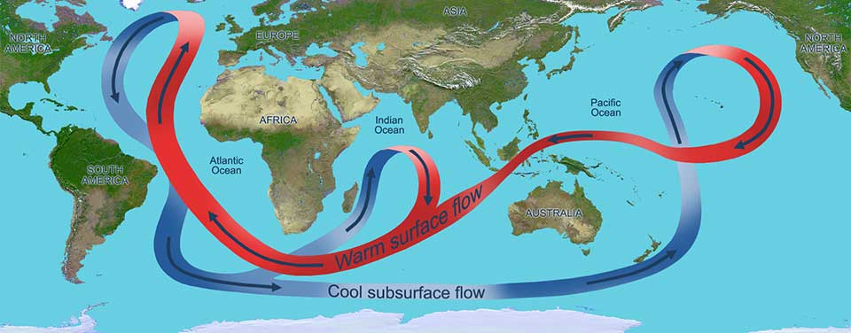
For 20 years, climate alarmists have claimed the ocean currents are slowing down and global warming is to blame. Slower ocean currents, they claimed, would alter African and Indian rainfall patterns and impact Atlantic hurricanes. As recently as 2019, alarmist “studies” claimed ocean currents had declined to their slowest pace in 1,600 years.
The latest scientific research, shows ocean currents have actually been speeding up. Now that evidence shows no slowdown, alarmists claim their computer models have always predicted that global warming would cause faster ocean currents.
The great ocean conveyor moves water around the globe. Cold, salty water is dense and sinks to the bottom of the ocean while warm water is less dense and remains on the surface.
Image: NOAA

Slide 28
Global sea levels have risen more than 400 feet since the beginning of the interglacial period, and data show they have always risen between ice ages.
Sea levels have been rising at a fairly steady pace since at least the mid-1800s.
NASA satellite instruments, with readings dating back to 1993, show global sea levels rising at a pace of merely 1.2 inches per decade.
Tide gauge data going back to the 1850s show a much lower rate, between 0.8 and 0.9 inches per decade, with no hint of acceleration.

Slide 29
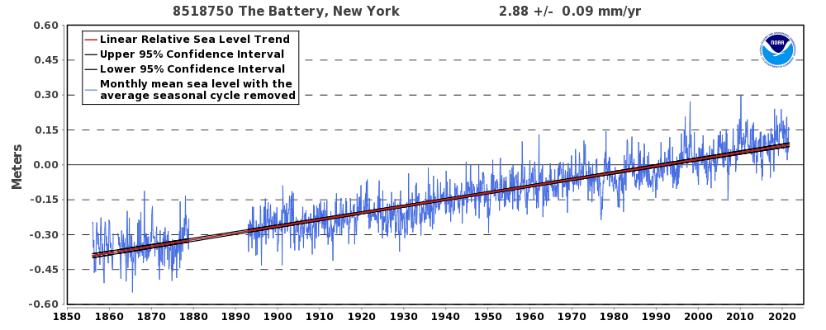
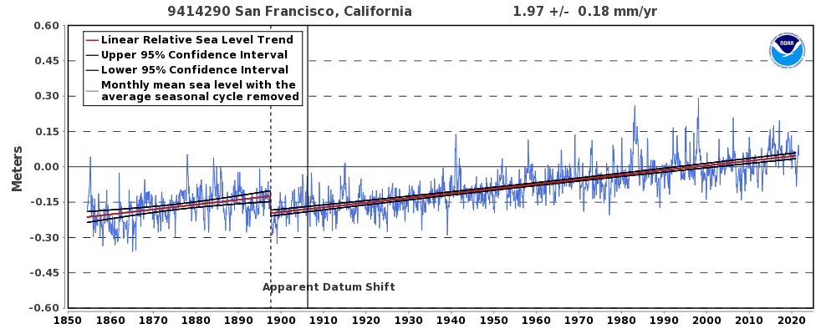
One of the oldest tide-gauge records of sea level, New York City’s “Battery,” shows a linear trend of 2.88 mm per year (0.113 inches per year) since 1856, with very little, if any, recent acceleration.
Tidal gauge measurements in NYC illustrate there has been a steady, modest pace of sea-level rise of a little more than 1 inch per decade since the 1850s.
In San Francisco, the rate of sea level rise is significantly less over the same time period, at 1.97 mm per year (0.078 inches per year), and also shows no acceleration.

Slide 30
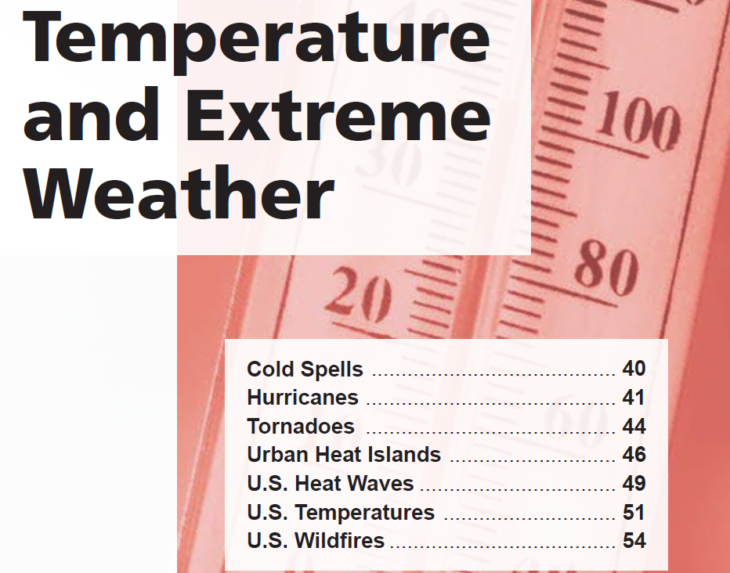
Section 3

Slide 31
Objective data show global warming has not caused an increase in the frequency or severity of cold weather events.
The U.N. Intergovernmental Panel on Climate Change reported in 2018 that it is “very likely” that there have been fewer very cold days and nights in recent decades.
The U.N. IPCC reports it is “virtually certain” that there will continue to be decreases in cold-weather temperature extremes.

Slide 32
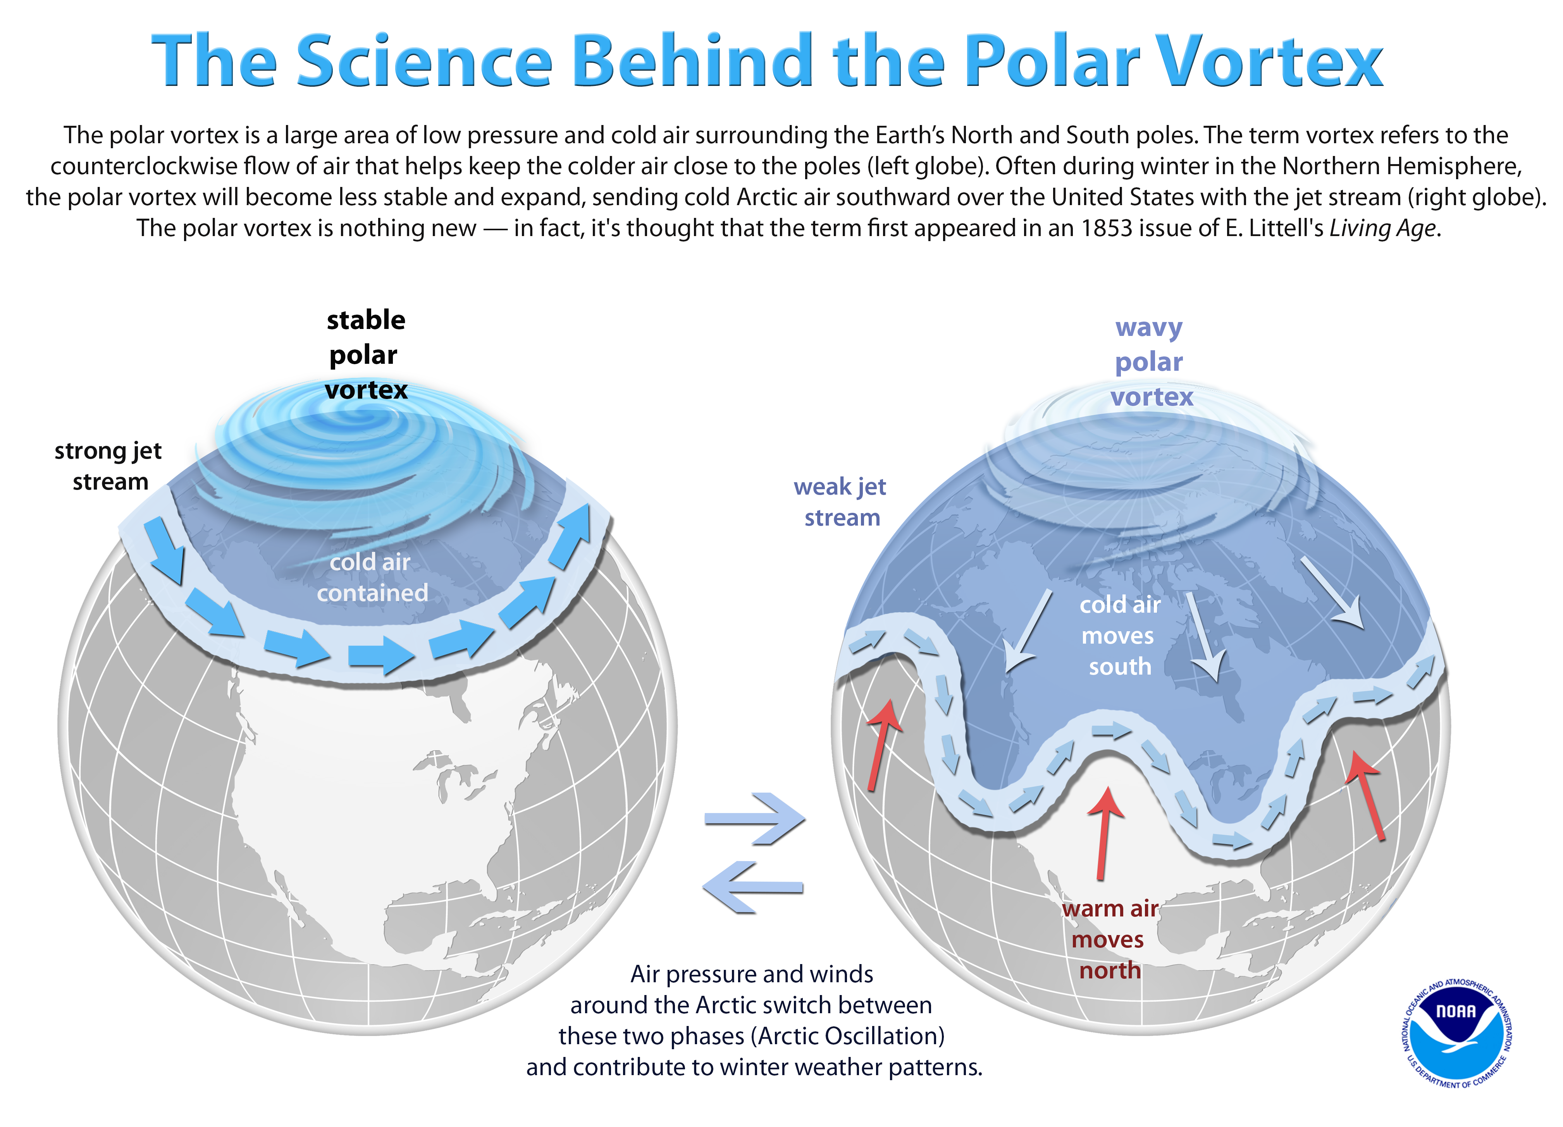
Climate activists frequently respond to polar vortex events and other extreme cold weather events by claiming climate change is to blame.
Not only does blaming cold weather outbreaks on global warming defy common sense, it also defies well-established scientific evidence and the findings of the U.N. Intergovernmental Panel on Climate Change (IPCC). The IPCC’s 2018 SREX report says it is “very likely” there have been fewer very cold days and nights in recent decades. The report’s authors further claim it is “virtually certain” that there will be “deceases in cold extremes” due to global warming.

Slide 33
Many researchers have found there has been no increase in hurricanes as the planet has modestly warmed.
The U.N. IPCC agrees, finding no increase in the frequency or severity of hurricanes.
The United States recently went through its longest period in recorded history without a major hurricane strike. The United States recently experienced its fewest total hurricanes in any eight-year period.
Florida, America’s most hurricane-prone state, recently underwent its longest period in recorded history without any hurricanes.

Slide 34
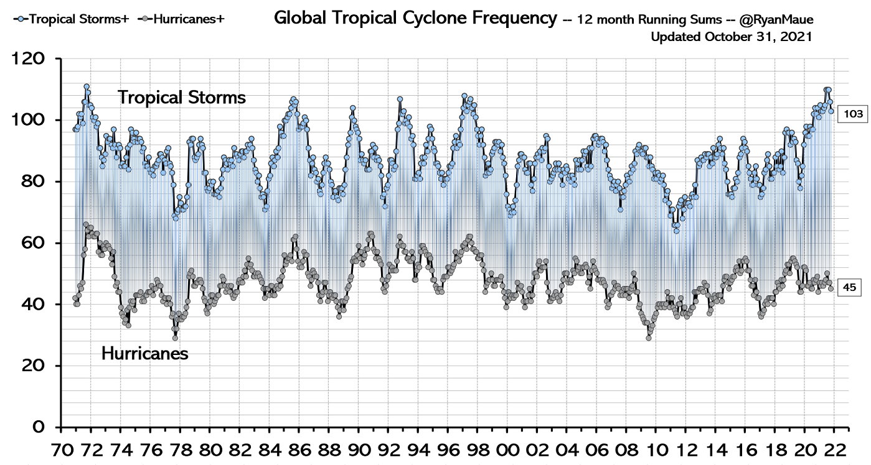
This figure shows that global hurricane and tropical cyclone activity is not increasing.
Even with the slight uptick in the number of tropical storms in 2021, it is still below the peak recorded in 1971.
Source: Global Tropical Cyclone Activity Dr. Ryan N. Maue https://climatlas.com/tropical/

Slide 35
The number of tornadoes in the United States has been declining for the past 45 years.
The number of strong tornadoes, rated as F3 or higher, has been dramatically declining for the past 45 years.
In 2017–18, the United States set a record for the longest period in history without a death caused by a tornado.
In 2017–18, the United States set a record for the longest period in history without an F3 or stronger tornado.
According to a climate report by the United Nations, “There is low confidence in observed trends in small spatial-scale phenomena such as tornadoes.”

Slide 36
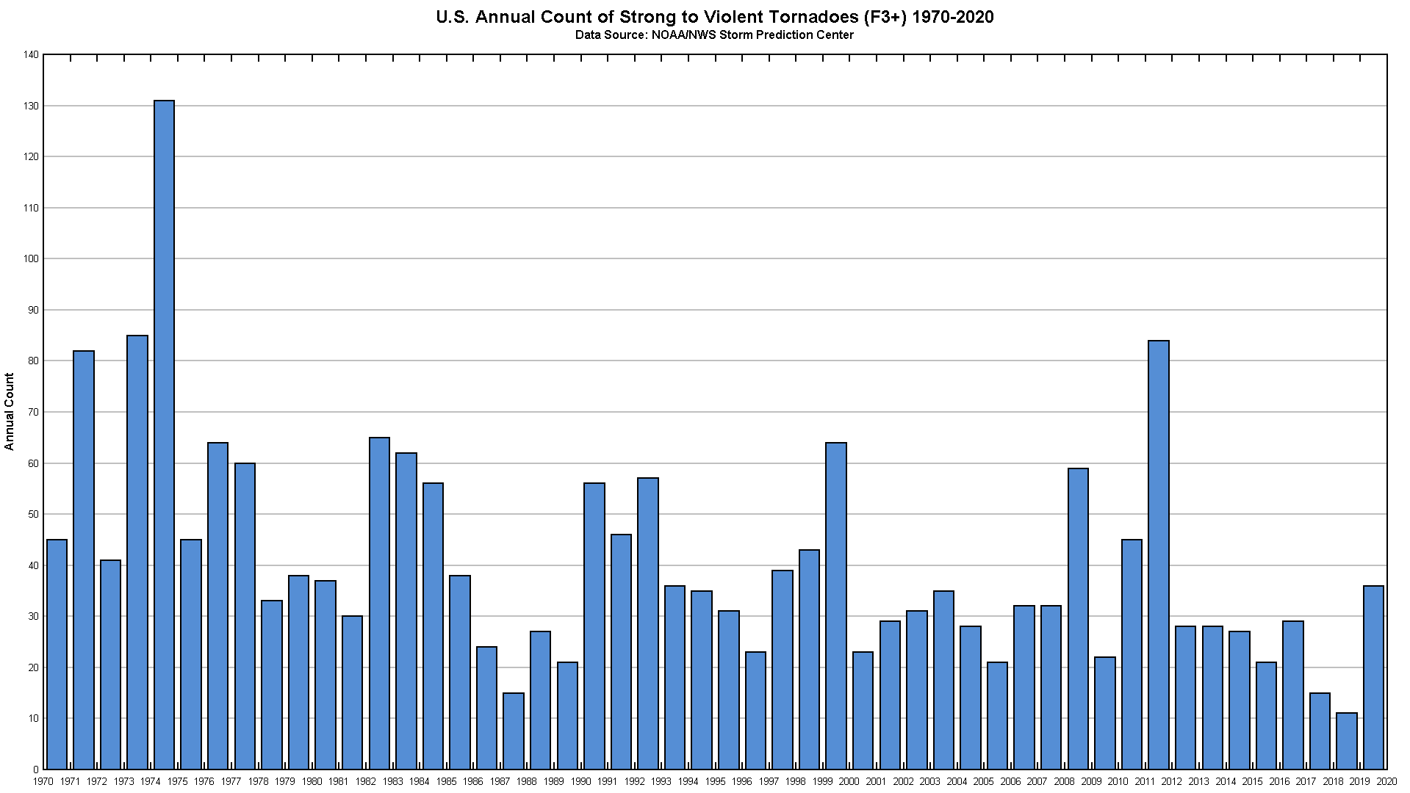
This figure shows the frequency of strong to violent tornadoes (tornadoes registering F3 or stronger) has been declining since the early 1970s.
The two record-low years for tornado strikes in the United States both occurred this past decade, in 2014 and 2018.5
Smaller tornadoes have seen an increase, due to better reporting, and better radar.
Sources: Graph by Anthony Watts using official NOAA/Storm Prediction Center data. https://www.spc.noaa.gov/climo/online/monthly/newm.html

Slide 37
Urban heat islands, which grow with the size of cities, create artificial warming at many long-term temperature stations.
On average, urban heat islands increase the global surface temperature trend by almost 50 percent.
Nearly 90 percent of U.S. temperature stations have been compromised by urbanization effects.
About half of the reported U.S. warming effectively disappears in the data when analysts consider only those stations that have not been corrupted by heat islands.

Slide 38
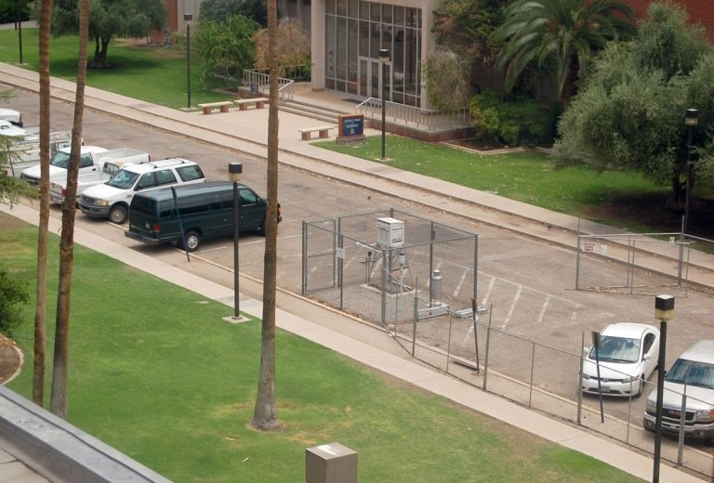
U.S. Historical Climatology Network weather station used to collect climate data.
This station is located in a parking lot at the University of Arizona in Tucson.
The station was previously located in a grassy area, but researchers moved the station as the campus grew.
Photo by Anthony Watts.

Slide 39
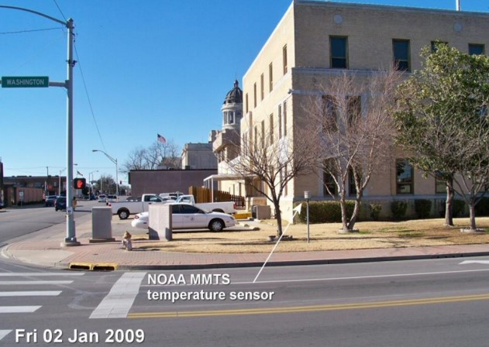
NOAA temperature sensor (used for climate data) located on street corner in Ardmore,
Oklahoma.
Note that the sensor’s data is being corrupted by heating signatures of the nearby building, asphalt, and automobiles.
Photo by Anthony Watts.

Slide 40
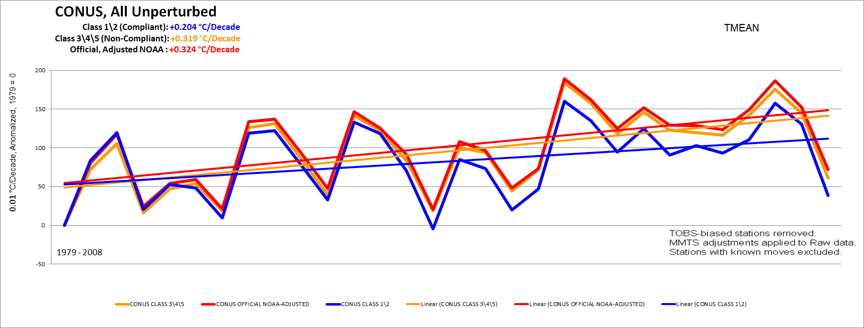
This graph shows that temperature stations that have not been corrupted by urban heat island impacts report much less warming (~50% less) than temperature stations corrupted by urban heat island impacts.
Yet, corrupted temperature stations are a majority of the stations used to report official U.S. temperature data and remain so today. There is strong evidence of this same sort of siting problem exists around the world, suggesting that the same upward bias manifests itself in the global temperature record.
Graph by Anthony Watts.

Slide 41
In recent decades in the United States, heat waves have been far less frequent and severe than they were in the 1930s.
The all-time high temperature records set in most states occurred in the first half of the twentieth century.
The most accurate nationwide temperature station network, implemented in 2005, has shown no sustained, substantial increase in daily high temperatures in the United States since its inception.

Slide 42
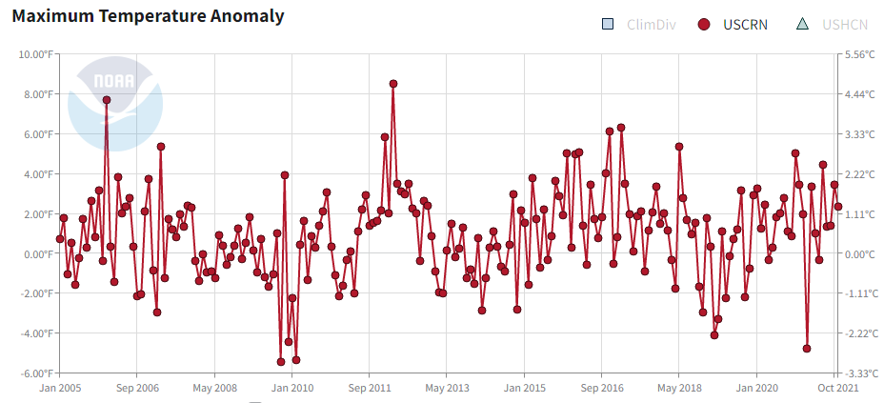
As Figure 1 from NOAA shows, there has been no sustained increase in daily high temperatures since at least 2005, when the National Oceanic and Atmospheric Administration launched its most accurate temperature station network, the Climate Reference Network for the contiguous United States.
Source: https://www.ncdc.noaa.gov/temp-and-precip/national-temperature-index/time-series/anom-tmax/1/0

Slide 43
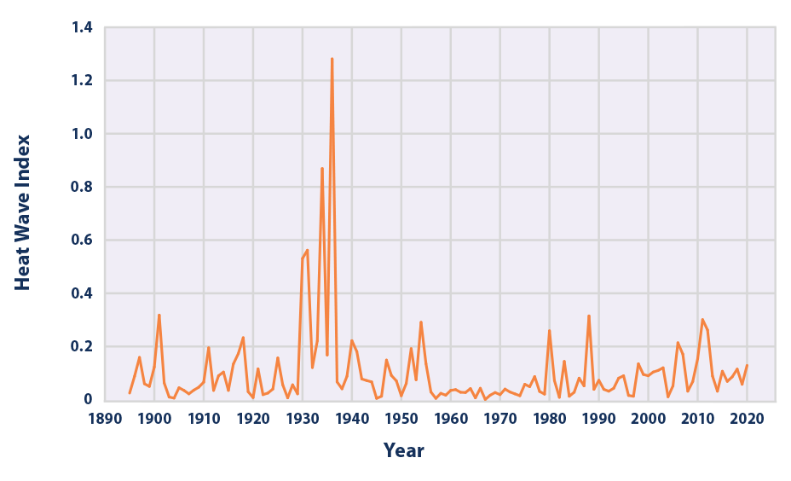
This figure shows the annual values of the U.S. Heat Wave Index, from 1895 to 2020 for the contiguous 48 states. This index defines a heat wave as a period lasting at least four days with an average temperature that would only be expected to occur once every 10 years, based on historical records. The data illustrated in the figure show extended periods of very high temperatures were much more common in the 1930s than they have been in the present decade.
Moreover, recent heat wave frequency and intensity remain in line with the historical norm today.
Source: Environmental Protection Agency https://www.epa.gov/sites/default/files/2021-04/heat-waves_figure3_2021.png

Slide 44
There has been no significant warming in the United States since 2005.
Any claimed recent warming and impacts at specific places in the United States are isolated and indicative of random variation, not a long-term warming trend.
Thermometer readings in the United States suggest current temperatures are similar to those temperatures recorded eight decades ago.

Slide 45
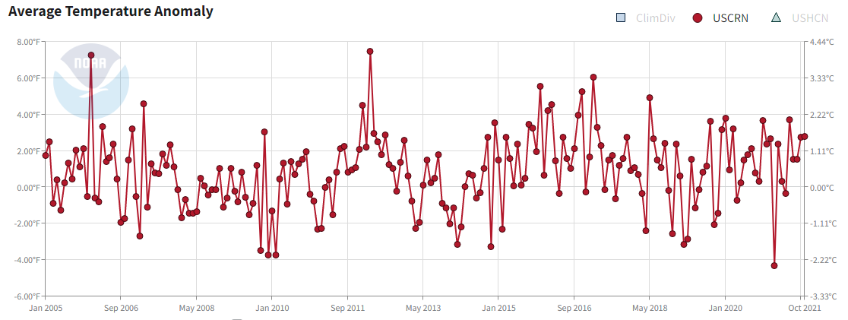
The United States has experienced no significant warming since 2005. The lack of warming is documented by the National Oceanic and Atmospheric Administration’s U.S. Climate Reference Network, an extremely accurate network of temperature stations located throughout the United States.

Slide 46
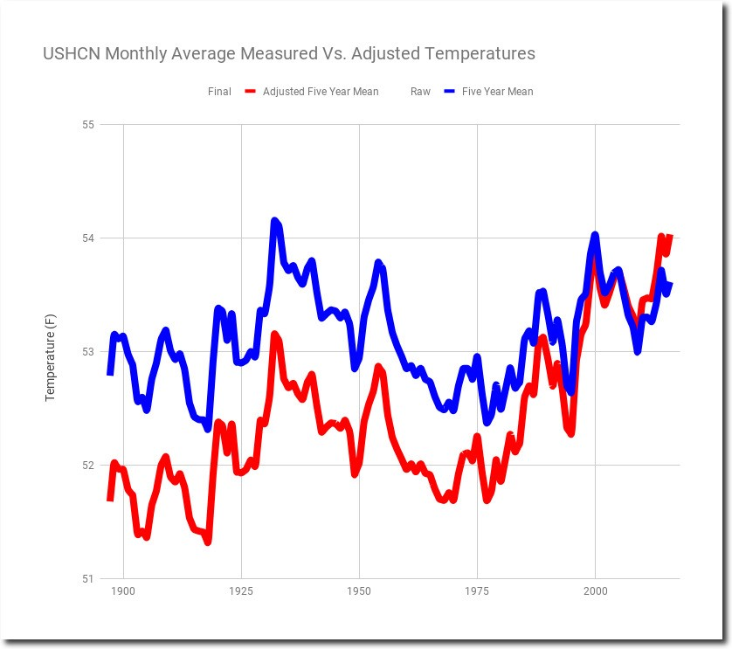
Thermometer readings report current temperatures are no higher today than they were 80 years ago.
This a reality that has been masked in large part by government agencies that have chosen to adjust temperatures from past decades downward, making it appear as though recent temperatures are comparably much higher than the unadjusted data suggest.
The blue line represents unadjusted thermometer readings, which show temperatures are no higher now than they were 80 years ago, in the 30’s and 40’s.
Source: Tony Heller, “61% Of NOAA USHCN Adjusted Temperature Data Is Now Fake,” realclimatescience.com, February 11, 2019: https://realclimatescience.com/2019/02/61-of-noaa-ushcn-adjusted-temperature-data-is-now-fake

Slide 47
Compared to the first half of the twentieth century, the number of wildfires occurring in the United States over the past decade is lower, and the fires have been less severe.
In years in which there has been an increase in wildfire activity over the past decade, the fires have usually involved substantially fewer acres of burnt land compared to much of the twentieth century.
Drought is the key climate factor for wildfires, an important consideration because the United States has experienced relatively few droughts recently.
Data showing greater numbers of acres lost to wildfires in previous decades were removed from an important database by a government fire agency, likely because the data did not support the claim that wildfires are becoming more frequent.
The trend of less recent wildfire is also supported by global satellite observations

Slide 48
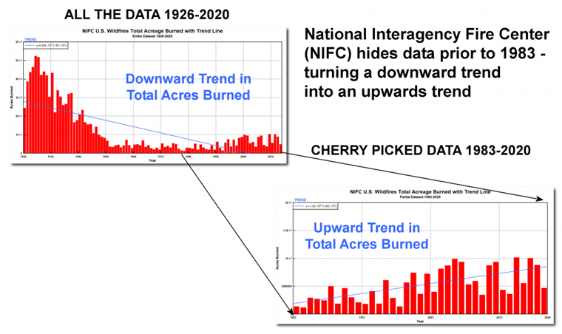
The U.S. National Interagency Fire Center (NIFC) provides data about U.S. wildfires dating back to 1926. NIFC data show the number of acres burned in recent years has been far less than it was during the early twentieth century.
At that time, the peak wildfire burn was greater than 52 million acres. From 2010 to 2020, the peaks were typically just 10 million acres or less.
Some climate activists cite a relatively small upward trend, starting in 1983, in the number of acres burned by wildfires as evidence that climate change has been making wildfires considerably worse.

Slide 49
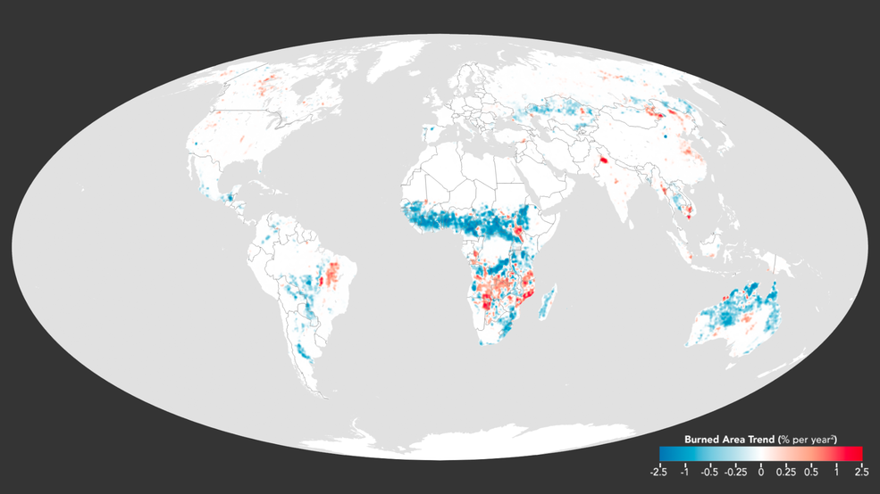
But, even if the U.S. National Interagency Fire Center (NIFC) data about U.S. wildfires dating back to 1926 is “inaccurate”, and only valid from 1983, satellite data says otherwise.
The global area of land burned each year declined by 24 percent between 1998 and 2015, according to analysis of satellite data by NASA scientists and their colleagues. Across Africa, fires typically burn an area about half the size of the continental United States every year. Note there is virtually no trend in the USA in this image.
Source: NASA Detects Drop in Global Fires, https://www.nasa.gov/feature/goddard/2017/nasa-detects-drop-in-global-fires

Slide 50
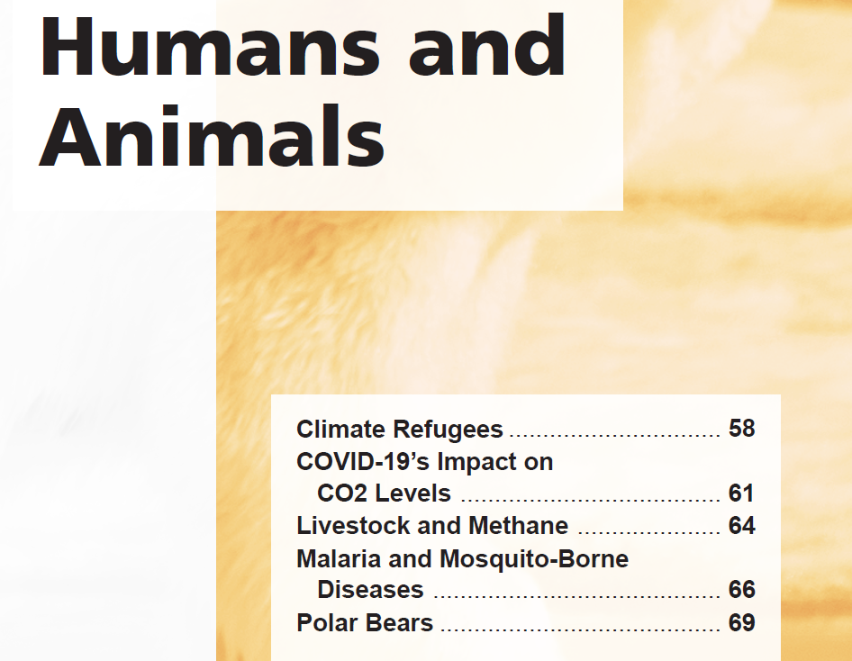
Section 4

Slide 51
The asserted causes of so-called “climate refugees”— increasing crop failures, catastrophic weather events, and islands lost to rising seas— have not materialized.
Despite much fear-mongering, a majority of the islands some climate alarmists have predicted would be associated with producing climate refugees due to sea-level rise have had their land mass increase in recent decades, not shrink.
Nearly all of the nations that are expected to produce climate refugees due to crop failures have benefited in recent years from steadily increasing crop yields.
The United Nations confirms casualties linked to climate related natural disasters have declined this century.

Slide 52
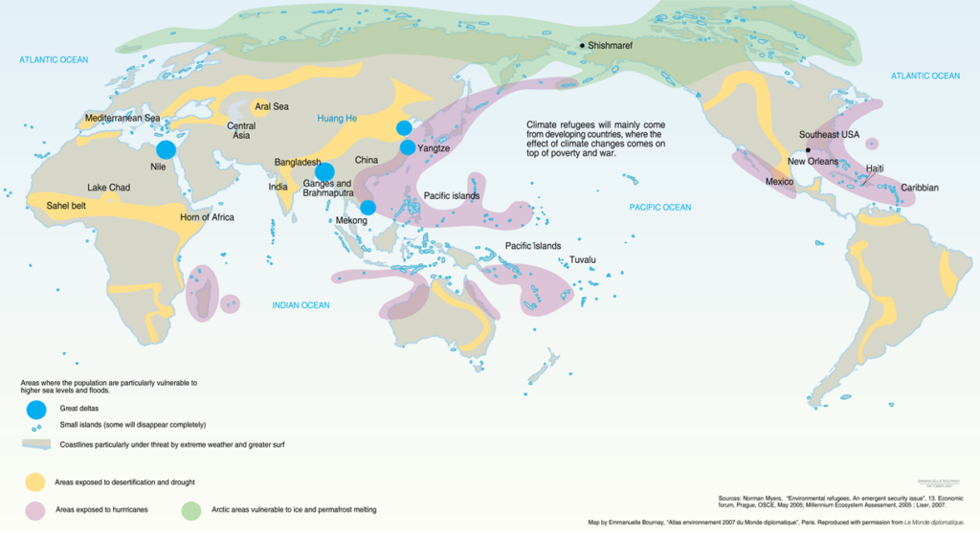
In 2005, the United Nations claimed, “Rising sea levels … will create up to 50 million environmental refugees by the end of the decade.”
Those predictions proved to be false, along with hundreds of others made by climate change alarmists.
To avoid embarrassment, the United Nations removed the prediction—which we reprint here.
Original map created in 2005 by the U.N. to illustrate where “50 million climate refugees” would be coming from. The map has since been “disappeared” from the Internet.

Slide 53
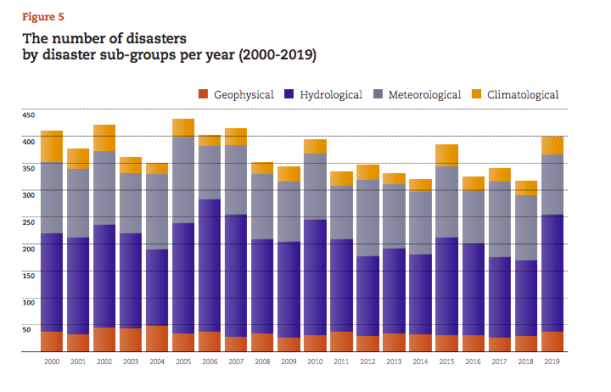
As documented in Climate at a Glance: Islands and Sea Level Rise, most small islands, including the “canary island in the coal mine, Tuvalu,” are growing in size rather than shrinking. As documented in Climate at a Glance: Crop Production, almost every nation on Earth is benefiting from steadily increasing crop yields as the Earth modestly warms.
And as documented by United Nations data, the number of climate-related disasters has been declining this century.
The above chart, published in the United Nations report, “The Human Cost of Disasters,” shows declining disasters by type in this century..

Slide 54
The global economy shrank as a consequence of the lockdowns instituted in response to the COVID-19 pandemic.
Despite crashing economies and large cutbacks in travel, industry, and energy generation, climate scientists have yet to find a substantial decline in atmospheric CO2 levels.
The lack of a strong reduction in atmospheric CO2 connected to the energy-use decline linked to the COVID-19 pandemic suggests that climate activists’ calls for global energy use reductions would be ineffective in limiting atmospheric CO2 levels. These policies would, however, cause significant economic harm.

Slide 55
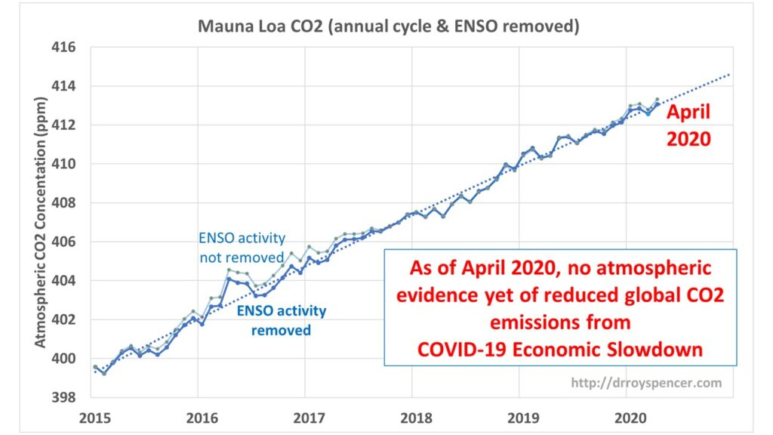
The result: no obvious downturn in global CO2 levels has been observed.
Climate activists expected this economic downtown to translate to less energy usage, and therefore less CO2 emissions globally. While that has indeed happened, with China seeing a 40% emissions drop, and an expected 11% reduction in energy-related CO2 emissions in the U.S., it didn’t translate into the proof they were seeking.
University of Alabama climate scientist Dr. Roy Spencer used a simple method for removing the large seasonal CO2 cycle, due to plant photosynthesis increases/decreases with seasons, from the Mauna Loa CO2 data, and well as the average effects from El Nino and La Nina events, which change the rate of ocean outgassing of CO2.
Analysis by Dr. Roy Spencer. http://www.drroyspencer.com/2020/05/why-the-current-economic-slowdown-wont-show-up-in-the-atmospheric-co2-record/

Slide 56
American ranchers and meat consumption have virtually no impact on overall greenhouse gas emissions or climate change.
EPA reports cattle and beef production account for 2 percent of U.S. greenhouse gas emissions.
EPA reports all livestock account for less than 4 percent of U.S. greenhouse gas emissions.

Slide 57
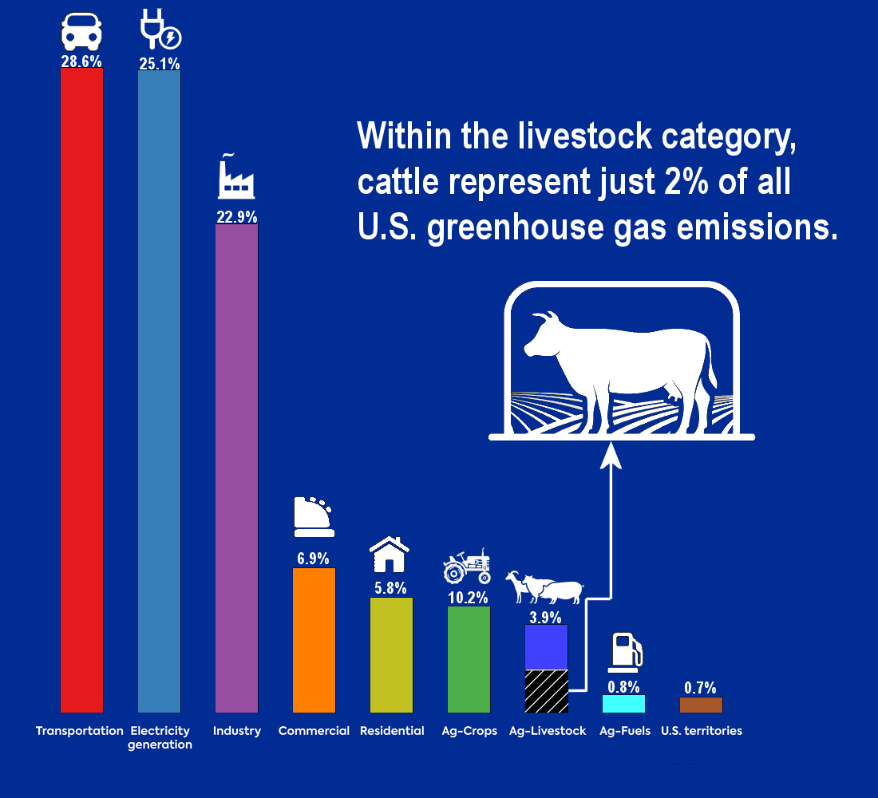
The U.S. Environmental Protection Agency (EPA) has compiled information on greenhouse gas emissions by source.
According to EPA, beef production accounts for 2 percent of U.S. greenhouse gas emissions, while all livestock production accounts for less than 4 percent of U.S. greenhouse gas emissions.
By contrast, U.S. agricultural crop production emits more greenhouse gases than total livestock production. This is the case even though the United States leads the world in beef production.
Source: Data from U.S. Environmental Protection Agency. Graphic by Anthony Watts.

Slide 58
The number of malaria deaths occurring globally has declined in recent decades, not increased, despite modest global warming.
The death toll for malaria worldwide has been cut in half since 2000.
There have been no recorded malaria deaths in North America or Europe since 1990, even though malaria deaths were frequent on both continents in the early 1900s.
If global warming causes an uptick in mosquito-borne diseases, malaria being the most prevalent, the world should have already seen a substantial increase in illnesses and deaths from malaria and other mosquito-borne diseases, not a dramatic decline

Slide 59
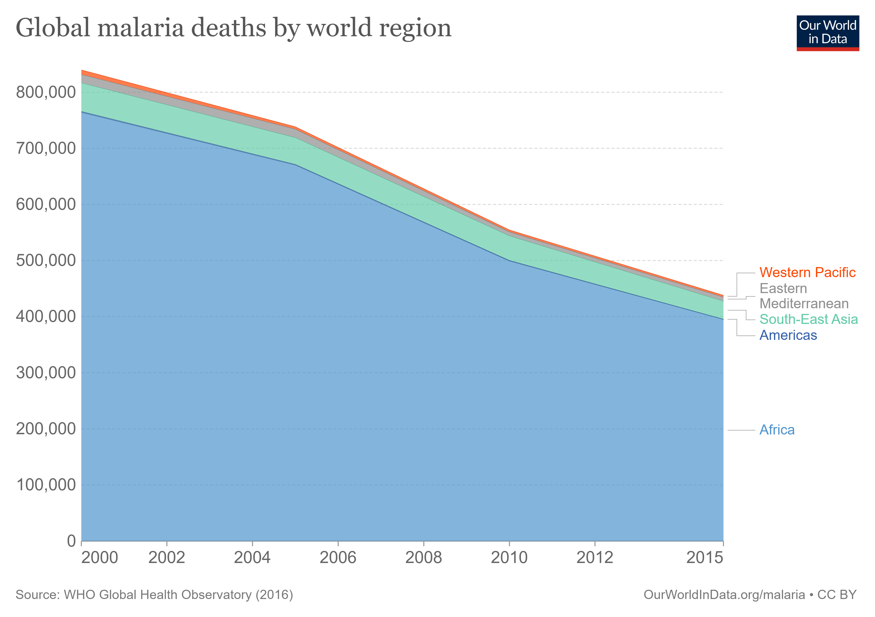
Claims that higher temperatures will cause more malaria cases and deaths are contradicted by real-world evidence.
As the Earth has warmed in recent decades, malaria cases and deaths have declined in nearly all areas of the world.
If global warming causes more malaria cases, we certainly should have witnessed additional deaths related to malaria by now.

Slide 60
Polar bear populations have increased dramatically during recent decades, despite the modest global warming that has occurred over the same period.
The estimated polar bear population has nearly quadrupled since 1950, rising from 10,000 bears in 1950 to as many as 39,000 bears today.
Polar bears evolved between six million years ago and 350,000 years ago, and they survived and even thrived in much warmer climates than what we’re seeing today.

Slide 61
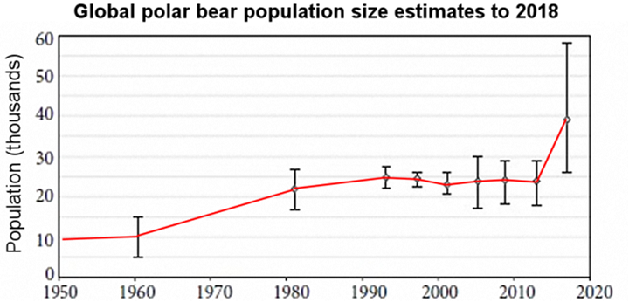
Climate alarmists often speculate that even a modest amount of warming would reduce Arctic ice and food availability so much that it would push polar bears to extinction.
After dropping to a low of 10,000 bears in 1950, during the middle of a global cooling period, polar bear numbers have quadrupled to as many as 39,000 today.
Further, polar bear experts, such as Dr. Susan Crockford, have documented at length how polar bear populations have managed to increase despite a modestly warming world.
Global polar bear population. Source: Susan J. Crockford, The Polar Bear Catastrophe That Never Happened, Chapter 10 (London, U.K.: The Global Warming Policy Foundation, 2019).

Slide 62
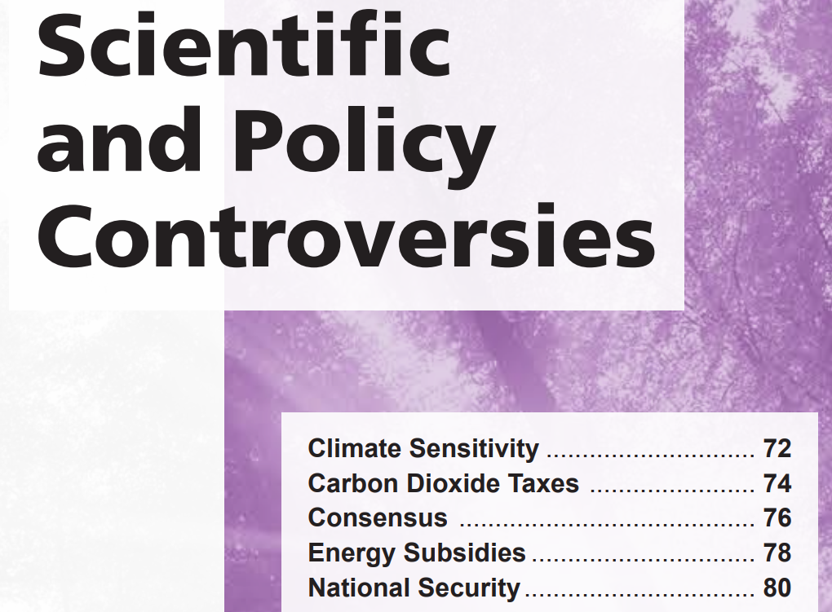
Section 5

Slide 63
Predictions that Earth will soon experience substantial global warming rely on the belief that there is a high climate sensitivity to a doubling of carbon dioxide emissions in the atmosphere.
For decades, scientists have debated the Earth’s climate sensitivity, due to the uncertain nature of climate feedback in various models.
Estimates in peer-reviewed studies range from eight-tenths of a degree C warming to almost 6 degrees C warming by 2100.
Such a large range means climate model temperature projections are dubious, at best, and cannot provide a reliable estimate that policymakers can depend upon.
The best evidence indicates climate sensitivity is at the lower end of the estimated range, unlikely to exceed 1.5 degrees C in the twenty-first century.

Slide 64
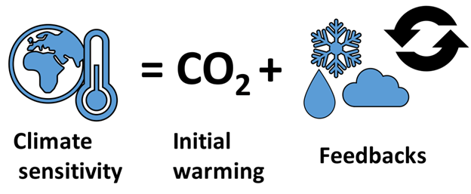
Climate sensitivity is a measure of how much the Earth’s climate will cool or warm after a change in the climate’s system.
In scientific circles, climate sensitivity is usually linked to the degree to which temperature will be affected by a doubling in carbon dioxide concentrations in the atmosphere.
After increasing carbon dioxide levels, there is an initial warming. This warming could be amplified or reduced by the net effect of various feedbacks (weather processes that change the characteristics of the planet).
Diagram by Femkemilene from WikiMedia Commons.

Slide 65
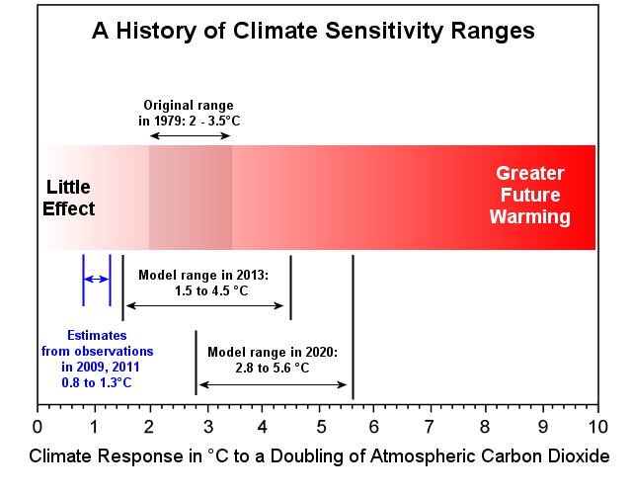
Declaring future predictions of global warming as “settled science” requires a fairly precise calculation of future temperatures.
However, since climate sensitivity gained scientific visibility more than 40 years ago, scientists and climate models have produced a very broad range of potential future temperature patterns, strongly indicating that no one model can be deemed reliable enough for policymakers to depend upon.
Mainstream calculations for a doubling of atmospheric carbon dioxide range from eight-tenths of a degree Celsius (1.04F) warming to almost 6 degrees C (10.8F) of warming by 2100.
Climate sensitivity estimates from new research beginning in 2009. Note that in blue, two studies using actual real-world data to infer climate sensitivity values between 0.8 and 1.3°C, far lower than model-based estimates. Diagram by Anthony Watts.

Slide 66
A “revenue-neutral” carbon dioxide tax is devised to be revenue neutral for government and only for government.
A “revenue-neutral” carbon dioxide tax is not revenue neutral for U.S. households.
Nearly all advocates of a carbon dioxide tax seek to impose the tax in addition to other government restrictions on carbon dioxide, not in place of them.
“Mainstream” carbon dioxide taxes of $50 per metric ton would likely raise gasoline prices 44 cents per gallon, at minimum.
“Mainstream” carbon dioxide taxes of $50 per metric ton would likely raise natural gas and coal prices—which account for nearly two thirds of U.S. electricity generation—62 percent and 330 percent, respectively.

Slide 67
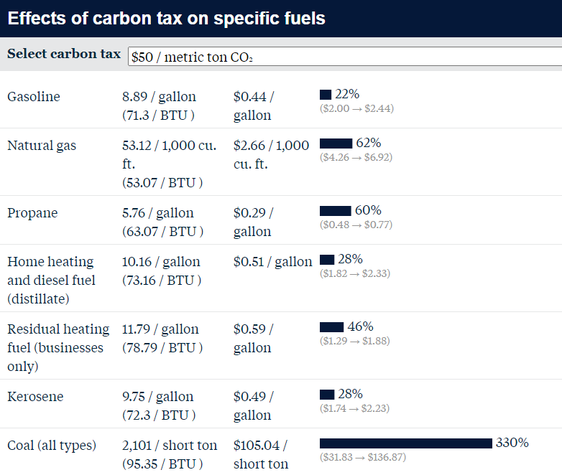
A carbon dioxide tax is a fee imposed on the use of carbon-based fuels, such as coal, oil, and natural gas.
Although carbon dioxide taxes have often been touted as “revenue neutral,” the purpose of a carbon dioxide tax is to make conventional energy so expensive that people will be coerced into buying wind and solar power, which is already very expensive.
The table at left shows costs added to common home and business fuels after the imposition of a carbon dioxide tax of $50/ton, based on common fuel prices in 2015.
Source: Marc Hafstead and Paul Picciano, “Calculating Various Fuel Prices under a Carbon Tax,” resources.org, November 28, 2017,
https://www.resources.org/common-resources/calculating-various-fuel-prices-under-a-carbon-tax

Slide 68
Facts and scientific evidence should always trump claims of “consensus.”
A majority of scientists (including skeptics) believe the Earth is warming and humans are playing a role, but a strong majority of scientists have said they are not deeply concerned about it.
The key debate between alarmists and skeptics is the issue of climate change impacts, not whether humans are causing some degree of warming.
If policymakers do choose to rely on consensus, the only consensus that ought to matter is whether scientists are extremely worried about climate change.

Slide 69
The work of science has nothing whatever to do with consensus. Consensus is the business of politics – Michael Crichton
Greatest failures of “scientific consensus”:
The Earth is the center of the Universe.
The sun and planets revolve around the Earth.
The universe is composed of four elements – Earth, Air, Fire, and Water.
The Earth is flat.
Spontaneous generation – a principle regarding the spontaneous generation of complex life from inanimate matter.
Static Earth – tectonic plate theory was highly criticized, and now accepted as fact.
Stomach ulcers are caused by stress, until a doctor proved otherwise by infecting himself with the heliobacter pyloris bacteria, and proved otherwise, earning as Nobel Prize.
Global cooling – in the 1970’s scientists believed Earth was headed for a new ice age.

Slide 70
Fossil fuels and conventional energy resources receive relatively few federal subsidies.
On its own, wind power receives more subsidies than all conventional energy sources combined.
Similarly, the solar power industry receives more subsidies than all conventional energy sources combined.

Slide 71
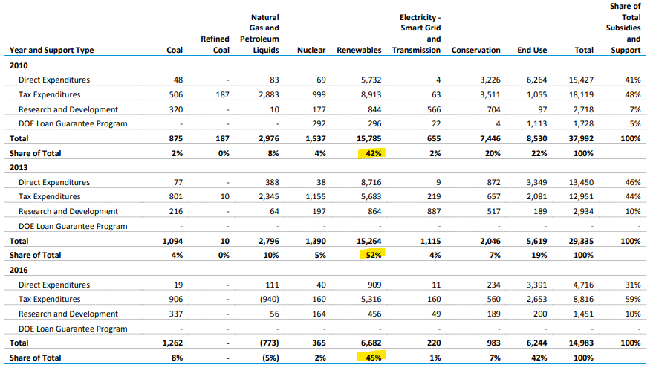
This table shows that the wind and solar power industries (renewables) each receive more subsidies than all conventional energy sources combined.
Source: U.S. Energy Information Administration, “Direct Federal Financial Interventions and Subsidies in Energy in Fiscal Year 2016,” Independent Statistics
and Analysis, Tables 3 and 4, April 2018, https://www.eia.gov/analysis/requests/subsidy/pdf/subsidy.pdf

Slide 72
Climate activism, not climate change, poses a significant threat to U.S. national security.
The economic strength of the United States is the single greatest factor for ensuring the American military remains dominant.
Proposals to restrict U.S. carbon dioxide emissions would impose expensive, unstable energy sources on Americans that could destroy the U.S. economy.
As shown earlier in this presentation, Earth’s modest recent warming is reducing national security “threat multipliers,” such as crop failures and weather related catastrophes.

Slide 73
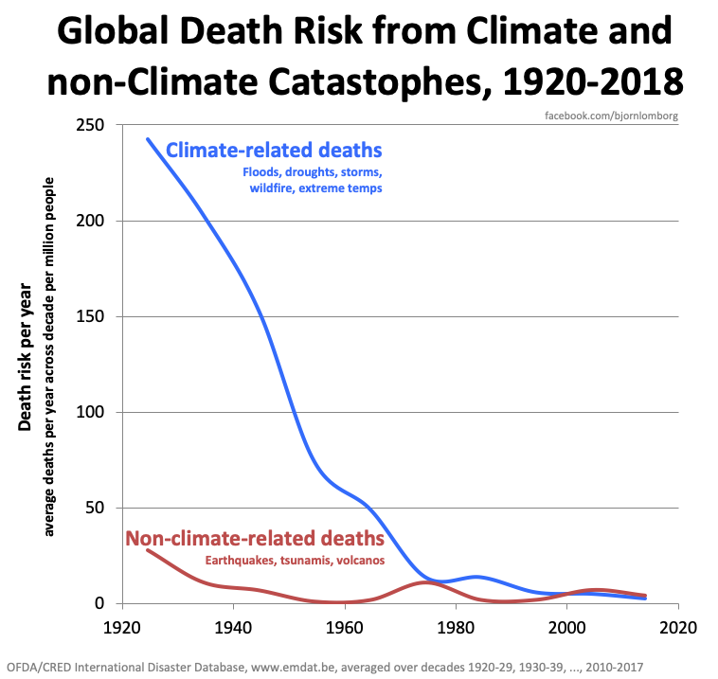
After nearly 100 years of climate change, ‘climate related deaths’ approach zero

Slide 74
What have we learned?

Slide 75
All references and citations for data, tables, and graphs in this presentation can be found at the website. A book version of this slideshow (print and digital) is also available.
Go to: https://climateataglance.com

